Slide 1


Maze Router
Ismael Elsharkawi
Mahmoud Elsayed
Ahmed Ehab Hamouda

Slide 2


Outline
Division of the work
The Input Parser
The A* Algorithm and Routing using A*
The LEF and DEF Parsers
Run Examples
Complexity Analysis

Slide 3
Division of the work
Ismael Elsharkawi
Built the Input Parser
Worked on some modifications in the A* Algorithm in python
Made the PNG drawer
Made the DEF and LEF parsers in python
Mahmoud Ahmed
Built most of the A* algorithm and its classes including the pins, the nodes.
Made most of the routing algorithm using the A* algorithm
Ahmed Hamouda
Worked on the A* algorithm in C++ before switching to python, then worked on it with python.
Fixed some issues in the A* algorithm

Slide 4
Design tradeoffs
Due to the limited time of the project, the router was developed using python
Python:
Easier implementation
Slower runtime
C/C++:
More complex implementation
Faster runtime

Slide 5

Input Parser
A class called InputParser was created.
It extracts the input pins locations for each net using regular expressions and saves them in classes of type Pin, there is a vector of pins that represents the net, that vector is pushed into the nets vector that is an attribute of the class InputParser.
PinsGrid is a python dictionary that takes a tuple of three elements representing the layer, y-coordinate, x-coordinate.

Slide 6
A* Algorithm
The A* algorithm depends on a priority queue called open_list.
At each position we are standing at, we calculate a function f, where f = g + h. g is the cost from the starting position until the current location, h is the heuristic function, that is the estimated cost of reaching the target.
Choose the position with the least value of f as the new position, remove it from the open_list and add it to the closed_list, we continue doing that until we reach any of the targets.
Create the children for each node and calculate the cost function for it and mark this node as invalid on the grid.

Slide 7
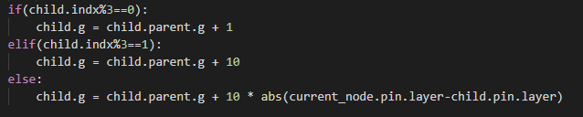
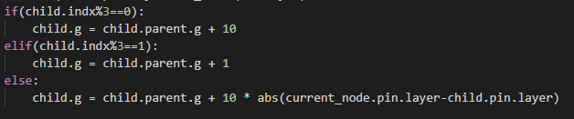
A* Algorithm: cost
The g function is calculated for even layers as :
The function g is calculated for odd layers as:

Slide 8
LEF and DEF formats parsing
We parse both the LEF and the DEF to make the input list that the input parser expects
The components, nets, pins, rows, tracks, etc. are saved in classes.
We get the location of each macro from the DEF file, then we get the relative location of each pin from the LEF file, then we get the nets from the DEF file again, then we get the location of the global pins.

Slide 9
LEF and DEF formats parsing
Open-source Parser
https://github.com/trimcao/lef-parser
Generated the needed input from the parsed data

Slide 10

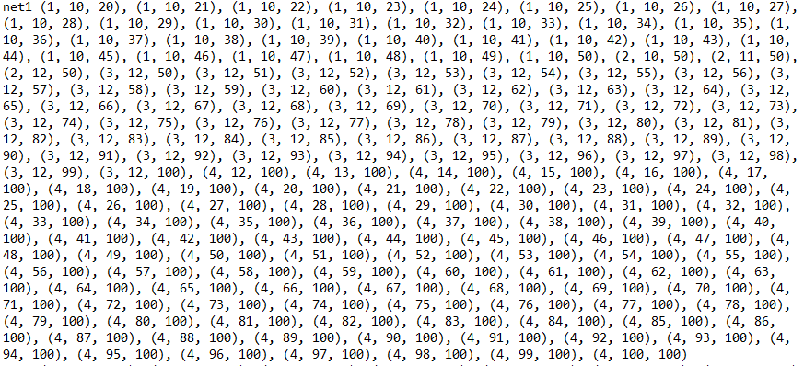
Example Runs
This is the input file
The output png images are shown in the following slides, one layer in each slide.
This is the output of the sample

Slide 11

Layer 1

Slide 12

Layer 2

Slide 13

Layer 3

Slide 14

Layer 4

Slide 15
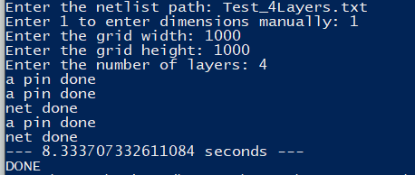
Performance
Runtime

Slide 16

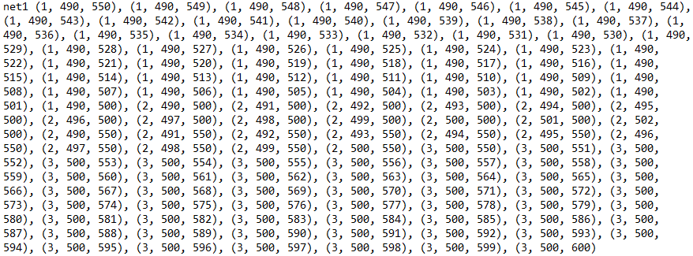
Example Runs
This is the input file
The output png images are shown in the following slides, one layer in each slide.
This is path of the output of the sample

Slide 17

Layer 1

Slide 18

Layer 2

Slide 19

Layer 3

Slide 20
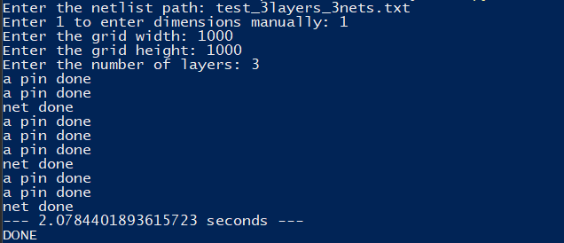
Performance
Runtime

Slide 21

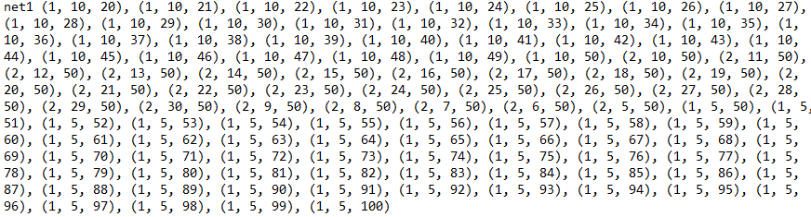
Example Runs
This is the input file
The output png images are shown in the following slides, one layer in each slide.
This is path of the output of the sample

Slide 22

Layer 1

Slide 23

Layer 2

Slide 24
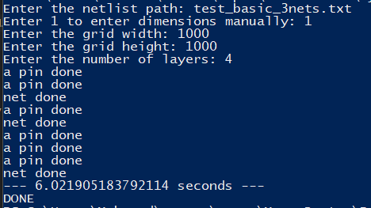
Performance
Runtime

Slide 25

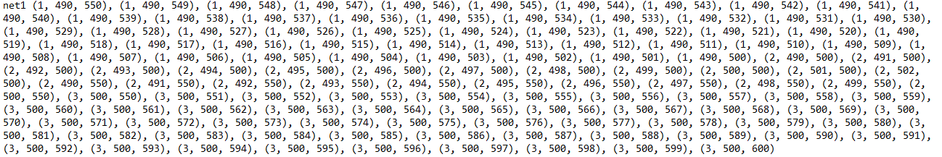
Example Runs
This is the input file
The output png images are shown in the following slides, one layer in each slide.
This is path of the output of the sample

Slide 26

Layer 1

Slide 27

Layer 2

Slide 28

Layer 3

Slide 29

Layer 4

Slide 30
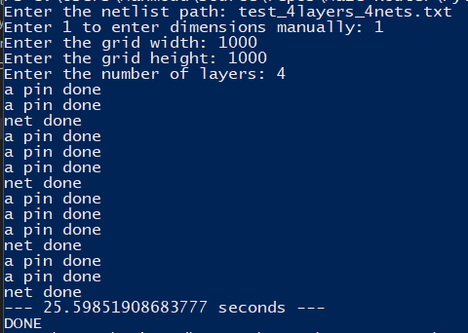
Performance
Runtime

Slide 31

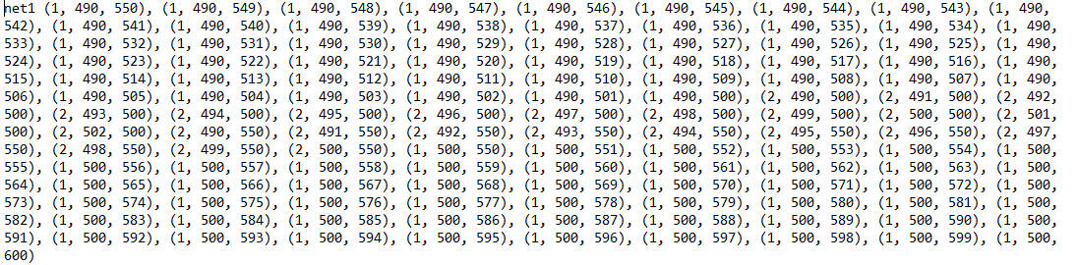
Example Runs
This is the input file
The output png images are shown in the following slides, one layer in each slide.
This is path of the output of the sample

Slide 32

Layer 1

Slide 33

Layer 2

Slide 34
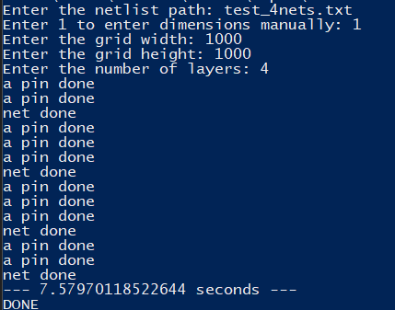
Performance
Runtime

Slide 35
Limitation
Python runtime slows down the performance
Memory complexity is high

Slide 36
Future improvements
Support all the DEF/LEF format information
Implement Rip-up Reroute
Check for the possibility of threading the routing to reduce time

